Slide 1


FRAUD DETECTION IN BANKING DATA BY MACHINE LEARNING TECHNIQUES
PRESENTED BY
AELLABOINA SAI RAHUL
MALLA REDDY INSTITUTE OF TECHNOLOGY AND SCIENCE
COMPUTER SCIENCE AND ENGINEERING

Slide 2
OUTLINE
PROBLEM STATEMENT
SYSTEM DEVELOPMENT APPROACH
ALGORITHM AND DEPLOYMENT
RESULT
CONCLUSION
FUTURE SCOPE
REFERENCES

Slide 3


PROBLEM STATEMENT:
Payments related fraud is a key aspect of cyber-crime agencies and recent research has shown that machine learning techniques can be applied successfully to detect fraudulent transactions in large amounts of payments data.
Such techniques have the ability to detect fraudulent transactions that human auditors may not be able to catch and also do this on a real time basis.
In this project, we apply multiple supervised machine learning techniques to the problem of fraud detection using a publicly available simulated payment transactions data.
We aim to demonstrate how supervised ML techniques can be used to classify data with high class imbalance with high accuracy.
We demonstrate that exploratory analysis can be used to separate fraudulent and nonfraudulent transactions. We use Machine Learning Alogorithms such as Catboost, Xgboost, LightGBM.

Slide 4
SYSTEM DEVELOPMENT APPROACH:
The proposed system, "Fraud Detection in Banking Data by Machine Learning Techniques," aims to address the growing challenge of fraudulent activities in banking transactions.
Leveraging advancements in technology and machine learning, our system employs class weight-tuning hyperparameters to effectively detect and mitigate fraudulent transactions while minimizing false positives.
First we apply the desired pre-processing on the data and further divide the data into two sections: training and testing.
It followed by performing Bayesian optimization on the training data to find the best which lead to the improvement of the performance.
We use the cross-validation method to obtain performance comparison in an unbalanced set and then examine the algorithms using different evaluation metrics, including accuracy, precision, recall, F1 score.

Slide 5
SYSTEM DEVELOPMENT APPROACH :
Utilization of Bayesian optimization to optimize hyperparameters, ensuring improved performance in detecting fraudulent transactions.
Implementation of weight-tuning as a pre-processing step for handling unbalanced data, enhancing the accuracy and reliability of fraud detection.
Itegration of ensemble learning techniques such as CatBoost, XGBoost, and LightGBM to further enhance detection accuracy through a voting mechanism.
Incorporation of deep learning methods to fine-tune hyperparameters, particularly focusing on weight-tuning, for superior performance.
Evaluation of system performance using recall-precision metrics in addition to the standard ROC-AUC, providing a comprehensive assessment of detection capabilities.
.

Slide 6
ALGORITHM AND DEPLOYMENT:
CatBoost Algorithm :
Catboost is a variant of gradient boosting that can handle both categorical and numerical features. It does not require any feature encodings techniques like One-Hot Encoder or Label Encoder to convert categorical features into numerical features.
It also uses an algorithm called symmetric weighted quantile sketch(SWQS) which automatically handles the missing values in the dataset to reduce overfitting and improve the overall performance of the dataset.
LightGBM Algorithm :
The LightGBM algorithm is built on the GBDT framework and aims to improve computational efficiency, particularly on big data prediction problems.
The high performance LightGBM algorithm can quickly handle large amounts of data, and the distributed processing of data which increase the training speed and reduce memory consumption.

Slide 7

ALGORITHM AND DEPLOYMENT:
XGBoost Algorithm :
XGBoost stands for “Extreme Gradient Boosting” and it has become one of the most popular and widely used machine learning algorithms due to its ability to handle large datasets
It is preferred over other gradient boosting machines (GBMs) due to its fast execution speed, model performance, and memory resources.
One of the key features of XGBoost is its efficient handling of missing values, which allows it to handle real-world data with missing values without requiring significant pre-processing.

Slide 8

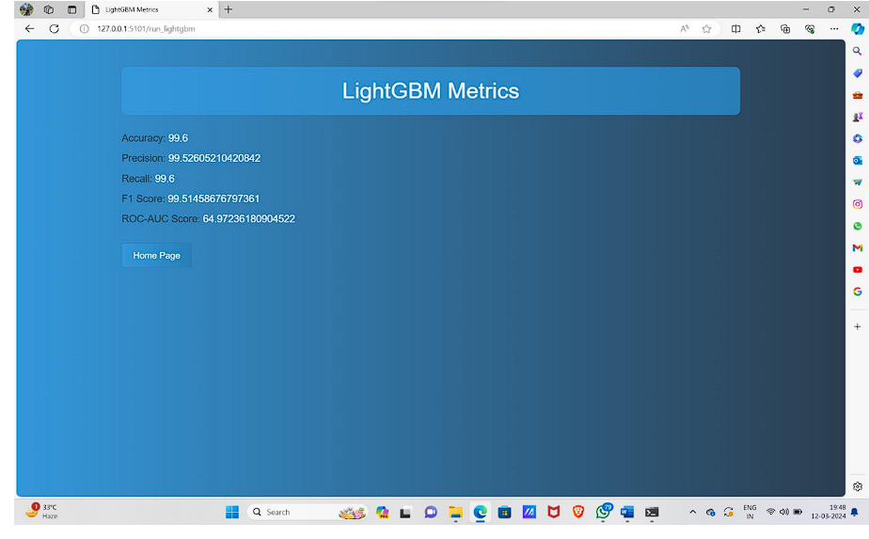

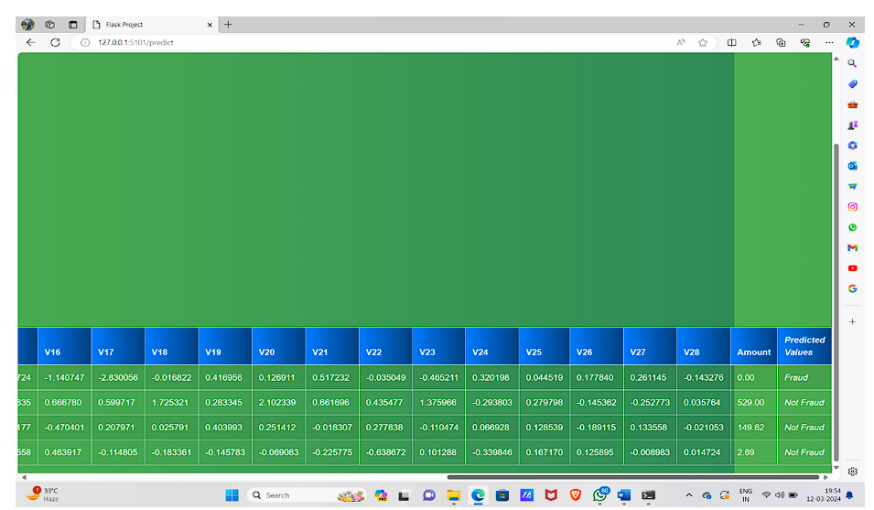
RESULTS:

Slide 9
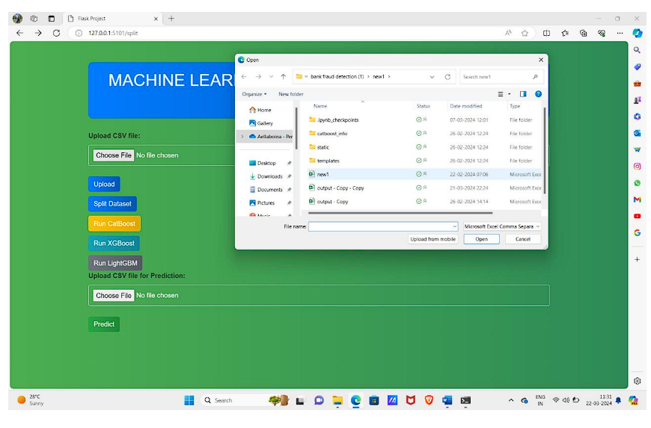
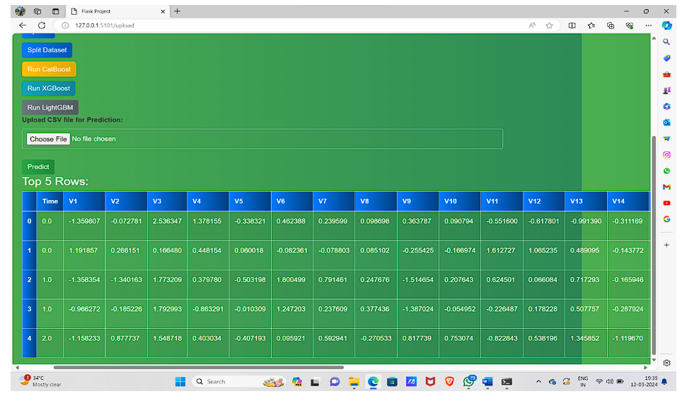
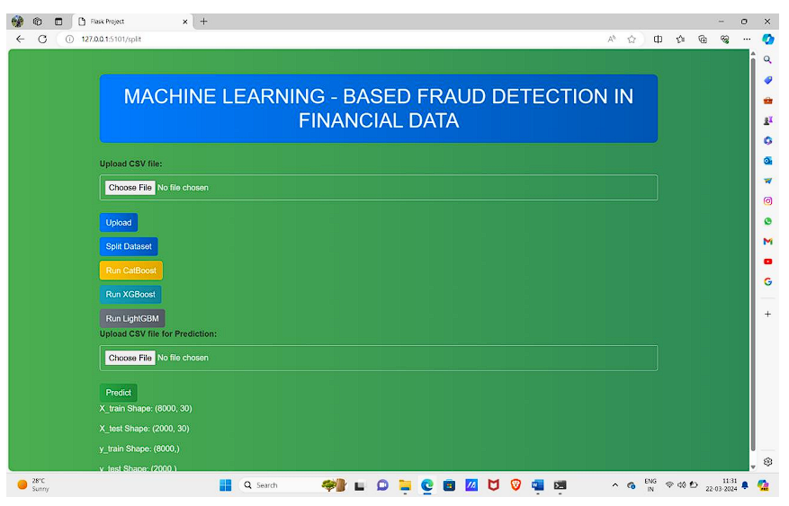
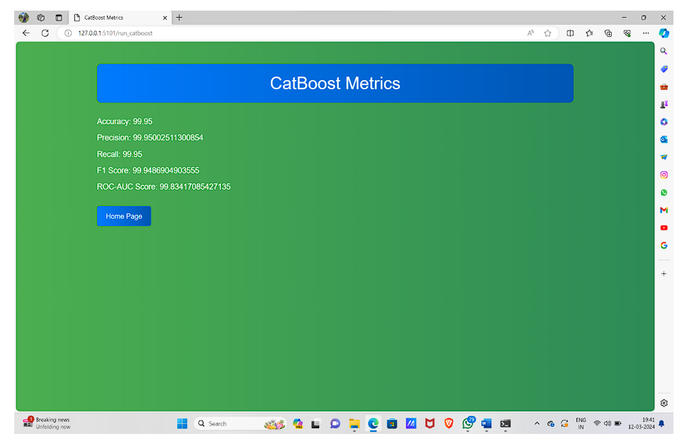
RESULTS:

Slide 10
CONCLUSION:
In this paper, we studied Traditional social-network-based recommendation algorithms generally utilize the coarse-grained trust relationships to generate recommendations, which seriously hinders the performance of recommendation algorithms.
To tackle this problem, we proposed a network representation learning enhanced recommendation algorithm in this study.
Finally, we integrate the _ne-grained dense trust relationships into the classic matrix factorization model to learn latent user and item feature vectors.
Experimental results on real-world datasets show that our proposed approach out- performs traditional social-network-based recommendation algorithms.

Slide 11
FUTURE SCOPE:
Data Encryption:
Encrypt data at rest using strong encryption algorithms (e.g., AES-256).Utilize envelope encryption, where each data object is encrypted with a unique data encryption key (DEK), and these DEKs are encrypted with a master key.
Employ client-side encryption before uploading data to the cloud, ensuring that data remains encrypted during storage and transmission.
Searchable Encryption:
Implement searchable encryption techniques such as symmetric searchable encryption (SSE) or order-preserving encryption (OPE) to allow searching over encrypted data.Utilize cryptographic protocols like secure multiparty computation (MPC) or homomorphic encryption to perform computations on encrypted data while preserving privacy.
Access Control:
Enforce fine-grained access control policies to regulate who can access, modify, or share data.Implement role-based access control (RBAC) or attribute-based access control (ABAC) to manage permissions based on user roles or specific attributes.
Utilize OAuth or similar authentication mechanisms to ensure secure authentication and authorization of users accessing the cloud resources.

Slide 12
REFERENCES:
[1] J. Nanduri, Y.-W. Liu, K. Yang, and Y. Jia, “Ecommerce fraud detection through fraud islands and multi-layer machine learning mode”
This paper introduces two Innovative methods, fraud islands (link analysis) and multi-layer machine learning model, which can effectively tackle the challenge of detecting diverse fraud patterns.
[2] I. Matloob, S. A. Khan, R. Rukaiya, M. A. K. Khattak, and A. Munir, ‘‘A sequence miningbased novel architecture for detecting fraudulent transactions in healthcare systems,’’
This paper presents a novel process-based fraud detection methodology to detect insurance claim-related frauds in the healthcare system using sequence mining concepts.
The proposed methodology generates frequent sequences with different pattern lengths.
[3] H. Feng, ‘‘Ensemble learning in credit card fraud detection using boosting methods,’’
In this paper we mainly tell how to cope with the credit card fraud detection problem by using boosting methods and also gave a contribution of the brief comparison between these boosting methods.

Slide 13
REFERENCES:
[4] M. S. Delgosha, N. Hajiheydari, and S. M. Fahimi, ‘‘Elucidation of big data analytics in banking: A four-stage delphi study,’’
The aim of this study is to understand and prioritize strategic applications, main drivers, and key challenges of implementing big data analytics in banks.
The results revealed that the most important applications of big data in banks are “fraud detection” and “credit risk analysis.”
[5] M. Puh and L. Brkić, ‘‘Detecting credit card fraud using selected machine learning algorithms,’’
In this paper we compare performance of three machine learning algorithms: Random Forest, Support Vector Machine and Logistic Regression in detecting fraud on reallife data containing credit card transaction.
To mitigate imbalanced class sizes, we use SMOTE sampling method.

Slide 14
THANK YOU

